Slide 1
Online security awareness
For the common (wo)Man

Slide 2
COntents
Course Objecttives……………3
Authors………………………...4
Passwords……………………...6
Emails…………………………13

Slide 3
Course objectives
This course is designed to be free and taught by anyone to any group.
Develop a basic understanding of security measures needed for the modern era of technology.
How to detect, avoid, and navigate through potentially bad emails.
How to avoid becoming a victim of identity theft.
Develop an understanding on common social engineering scams.
How to secure your online presence.
What to do if you become a victim of identity theft.
How to get tools to help defend yourself before or after becoming a victim of thieves.

Slide 4
Authors
This course was developed and sponsored by Off The Rails: Cyber Security Podcast hosts:
Brandon Rickman
Matthew Weidner
Liam Seeley
Gina Cramer

Slide 5
How to access this Course for later
Go to github…(google drive?)

Slide 6
Part i: Passwords
Keys to the computer world

Slide 7
Strength in numbers
The have’s
The have not’s
Passwords get their strength in three main areas:
Length – a general rule of thumb is 8 to 10 characters.
Upper and lower case combined
Special characters - !@#$%^&*(){}][;”
Random characters are your friends.
Use ANY word in any dictionary
Use personal sequence of numbers
Changing letters for symbols i.e.:
Pa$Sw0rD1 for password1
Use the same password on different accounts.
Change ending/beginning numbers when required to update password.
Password12 → Password13

Slide 8
Password Managers & Generators
A simple way to ensure passwords are kept safe and easy for you to retrieve, is to use Password Managers, aka key lockers.
There are several ones out there, some paid, some free.
https://1password.com (paid) $2.99/month billed annually, across all devices.
https://keepass.info/ (free) held locally on pc and connects across accounts.
Use password generators to generate random 10 to 16 character passwords. (Longer is better)
Most password managers will have a generator included. (Keepass does)
https://my.norton.com/extspa/idsafe?path=pwd-gen is an online password generator.

Slide 9
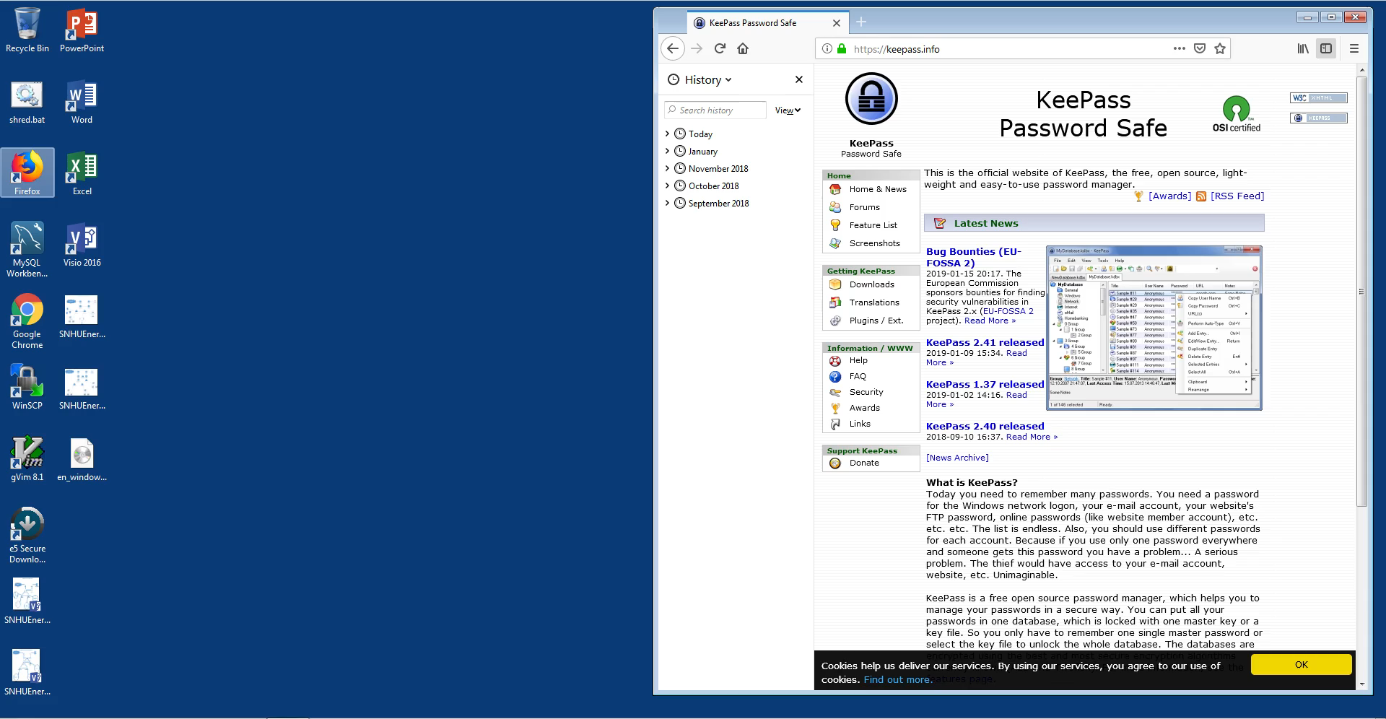
Using keepass (6:04 min) by matt weidner
Download and install Keepass
Create New database
Saved to the Desktop
Add new entry
Generate new password
Store a copy of database on USB drive and lock USB drive in safe or lock box
Open database and password for before logging into the website you are using
**NOTE**
Keepass is encrypted at rest, meaning that it would have to be decrypted to gain access to your passwords.

Slide 10
MFA, biometrics, and yubikey
MFA (Multi-Factor authentication
Biometrics and Yubikey
Defined as: combines two or more independent credentials:
User password
Security token (yubikey)
User biometrics
The goal being to layer the defense with several ways to ensure the right person is using the computer/website, as necessary.
https://www.yubico.com/ - is the makers of Yubikey
Biometrics (fingerprint, facial recognition, and iris scanning) are additional forms of authentication

Slide 11
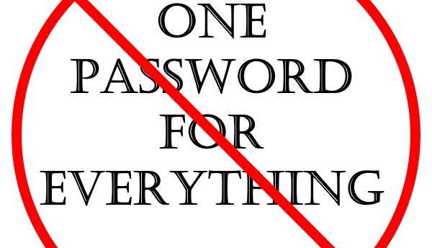
All for one and one for all passwords

Slide 12
Part ii: Emails
The internet’s quick connection to sharing information

Slide 13
Phishing emails
Defined as: fraudulent attempt to obtain sensitive information such as usernames, passwords and credit card details by disguising as a trustworthy entity in an electronic communication. Wikipedia
These types of emails attempt to gather information about you.
They can be faked with what seems like legitimate company information. (No company IT Department should ask for your login information or personal identifying information, PPI, through email).
If you did not request the email related to sensitive information, contact the company that is represented in the email. DO NOT USE THE NUMBER PROVIDED IN THE EMAIL

Slide 14
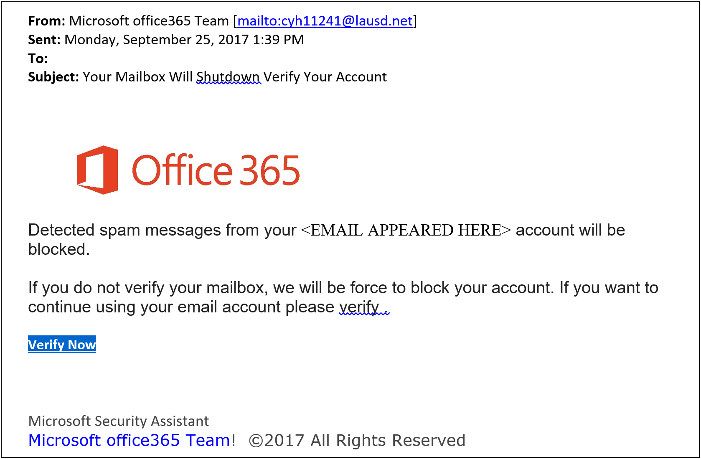
Fake email #1
Header: “o” in office isn’t capitalized. This is their logo and brand name, they aren’t going to mess that up. Sender email does not have a domain [area after @ symbol] that comes back to a Microsoft domain.
Body: Outlook already blocks Spam emails, go look at the folder in your email labeled SPAM.
“verify .” All though this is small, it is a tell-tell sign that a human wrote this verses a computer auto-generated email, which this would be from Microsoft.

Slide 15
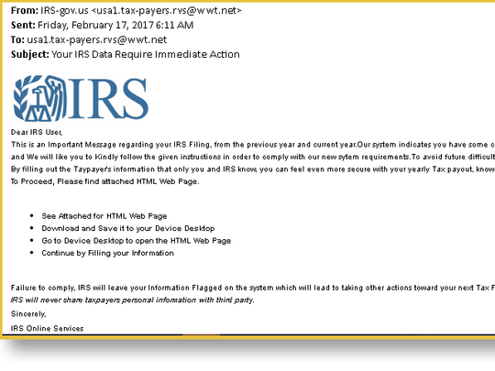
Fake email #2
Header: email does not come back to irs.gov after the @ in the from tag.
If you are not expecting an attachment DO NOT touch it or even click on it. Some malware is set to install upon download.
The email states you must see an attached HTML page, why wasn’t it just linked in the email?
Last, “continue filing out your information”. This is the IRS, they have your information.

Slide 16
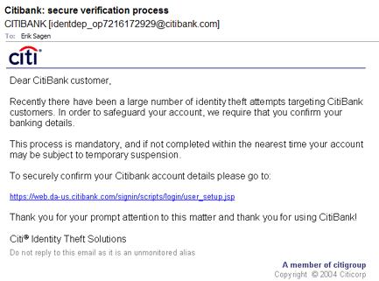
Fake email #3
This email is a good one. The email from CitiBank appears to be legitimate. The website appears to be a possible domain from CititBank.
The major problem is that CitiBank SHOULD not and more than likely WILL not be sending an email asking you to verify your account.
If you want to check if CitiBank needs you to update your information, utilize the message feature in your secure online banking platform. They will send something there.

Slide 17
Deceptive links
Check the return email address: does the Domain (area after the @ symbol) match the company sending the email; Most companies will have their own domain from email and websites that are name after their business. Try it! Go to a known website that you trust and then also look at any emails from that company. Do they match?
Unexpected files in email, even if someone you know but still weren't expecting a file, is a no go until verified by the sender.
Hovering over links to see real target: move your mouse over top of the link; DO NOT click it; after a few seconds the URL (web address) will show up on a pop up next to your mouse pointer.
Do not to trust bit.ly links: these are used legitimately sometimes to shorten long URLs, but are great ways to hide where the actual link sends you.

Slide 18
Online banking
Use the new password standards we learned about in Part I of this presentation to have a stronger password. Maybe even use your new Password Manager?
Login using your username and password.
Find your message center: this is going to be where all important and sometimes not so important contact between you and your bank will take place. All banks have this feature.
When you are done with your business on the website, be sure to LOG OUT. Some banks and other website will automatically log you out after an inactivity period, but make it a habit to log out.

Slide 19
Part iii: scams and Identity theft
The way the new bad guys are trying to steal your money

Slide 20
What is an online scam?
Online Scam is defined as: is a term used to describe any fraudulent business or scheme that takes money or other goods from an unsuspecting person. With the world becoming more connected thanks to the Internet, online scams have increased, and it's often up to you to help stay cautious with people on the Internet.
Types of Online Scams: Phising, Auction Frauds, Catfish, Donation Scam, Cold Call Scam, 419 aka “Long lost African relative scam”, Online Survey Scam, Chain Mail
(https://www.computerhope.com/jargon/s/scam.htm)

Slide 21
Other types of scams
Scams can come from phone calls, emails, and even websites or google searches.
Google searches: ensure you are not clicking an add link; they are using the first few returns on a search; they can be fraudulent; notify google.com if you find one (Google does not have a phone number customer support, its all online and thru email).
IRS scams are common: most of the time they will call and say you have a warrant for your arrest. This is false. If the IRS wants to arrest you they will just show up at your house or work. The IRS will always try and call or email when there is a problem. The IRS has your information and if they want your money they will just take it from your paycheck through your employer.
Dating scams: Military or Catfishing, dating scams are meant to mainly hurt the other person by getting you excited about the person you are meeting and its not who you though it was. There have been times where people were extoreted online because they sent inappropriate pictures and the receiver (scammer) states they will expose the sender unless they pay. This IS illegal, gather as much information about the other person as you can.
Utility company scams: They need to install a new electric meter or work on the cable or satellite system update, but you need to pay a deposit before they can start. Sometimes the company isn’t even service the area where you live.

Slide 22
Update security breaches
Have you received an email that your information was part of a security breach?
That you need to get credit monitoring?
Everyday, it seems there is a new major security breach at companies that we entrust with our information.
When you see these in the news head over to Troy Hunt’s website www.haveibeenpwned.com
Here you will find out if your email is part of any data breaches dating back.
Major Data Breaches: OPM (Federal Government HR), Experian, Medicaid, Yahoo, and many more.

Slide 23
What if I’m Being Scammed Right now
Have you given them access to your computer or bank account?
Are you on the phone with them or are they expecting a return call?
If you have not given them access to your computer (sometimes even if you have given remote access) unplug the computer from the power. This will stop their ability to continue accessing your info. Also go unplug the internet router. This stops all outside access.
If you are on the phone with them or they tell you they want you to go do “something” call the local police and have an officer come out. You can alternatively go to you police department’s lobby and request to speak with an officer. They are open 24/7 so don’t wait, make a report. Even if there hasn’t been a offense yet.
Contact your bank and credit card companies to alert them of the fraud (only if you have given them this info).
NEVER get gift cards for payment or send money via Moneygram/Western Union unless you know personally know who and where you are sending the money. Both of these companies clearly spell this out in the fine print.

Slide 24
Part iV: Social Engineering
Gathering intel about you to take your money and your identity

Slide 25
Part v: securing your online presence
How to fight and take back your control

Slide 26
Part vi: defensive programs
Tools to help you secure your identity and online presence

Slide 27
Part vii: what to do after becoming a victim
How to recover some sense of self after a scammer has attacked you

Slide 28
Part viii: Beyond this course
Resources, tools, and other goodies to help further your new education

